Slide 1
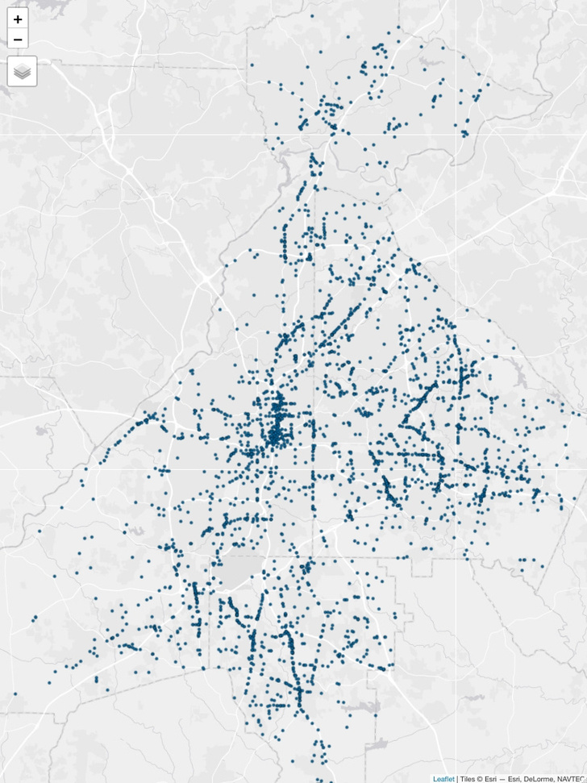
GEOG 202
Final Presentation
DAVIS COVER

Slide 2
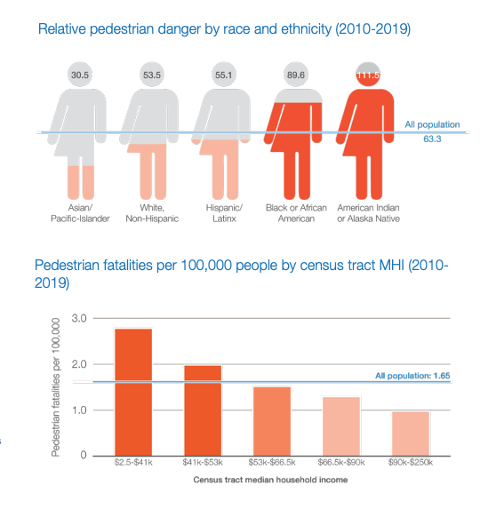
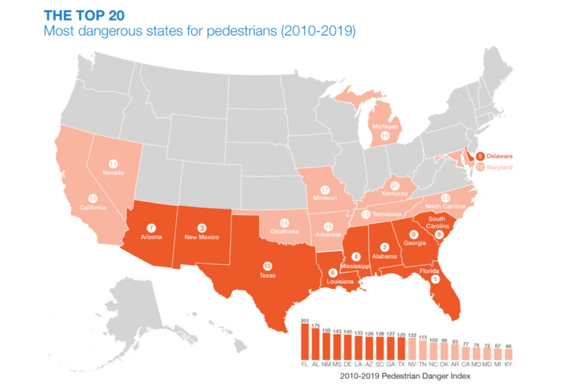
INTRODUCTION
Analyzing patterns of pedestrian collisions in Metro Atlanta, Georgia, USA
Source: Dangerous By Design (2021), National Complete Streets Coalition & Smart Growth America

Slide 3
Datasets
Research Questions/Methods
2019 American Community Survey 5-year estimates by census tract
Georgia State Department of Transportation crash reports 2016-2020
1. Do census tracts with lower incomes experience more pedestrian-car collisions?
Method: Correlation test & simple linear regression
2. Do census tracts with higher population density experience more pedestrian-car collisions?
Method: Correlation test
3. Is there an association between census tracts with high percentages of commuters by foot/public transportation and pedestrian-car collisions?
Method: Correlation test
4. Are pedestrian-car collisions clustered within the three counties Atlanta encompasses?
Methods: Refined nearest neighbor (G-function) & hot spot analysis
5. Is there a statistically significant difference in collisions by county?
Method: Kruskal-Wallis & Dunn test

Slide 4
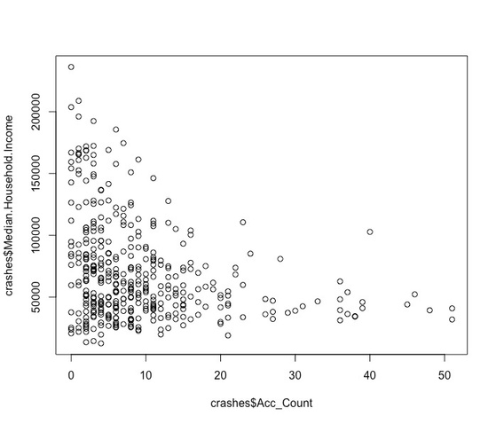
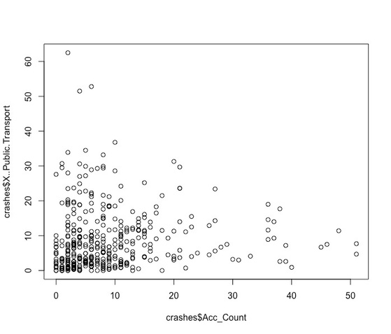
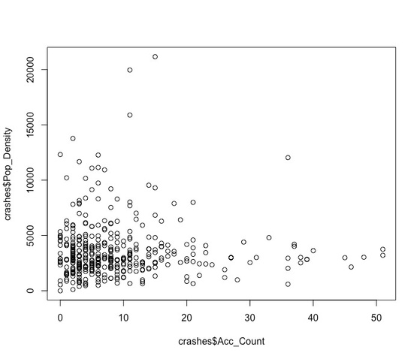
Results: Correlation Tests
Median Household Income
% Public Transportation
Population Density
Result: Correlation coefficient of -0.28,
p-value of < 0.001
Also ran simple linear regression model:
Multiple R-squared of 0.08, p-value < 0.001
Result: Visually, appears to be a negative correlation.
However, correlation test gave a coefficient of 0.05, p-value of 0.32
Result: Visually, also appears to be a negative correlation.
However, correlation test gave a coefficient of -0.0092, p-value of 0.86

Slide 5
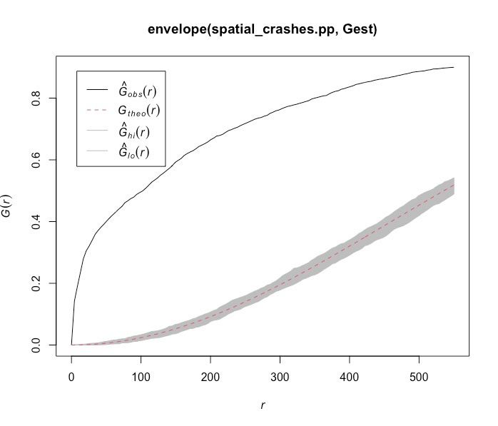
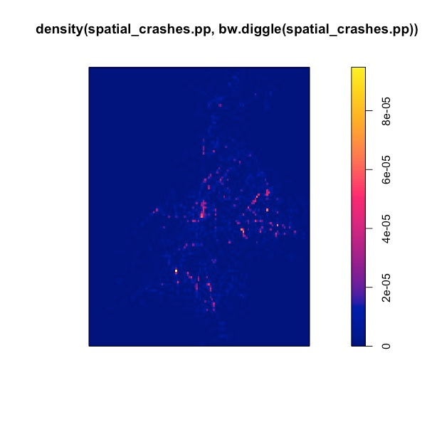
Results: Spatial Analysis
01.
Refined nearest neighbor
02.
Kernel density map

Slide 6
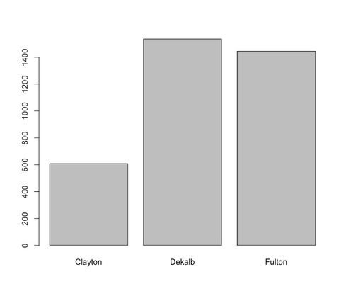
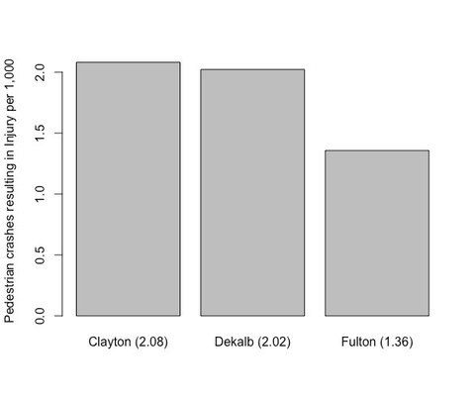
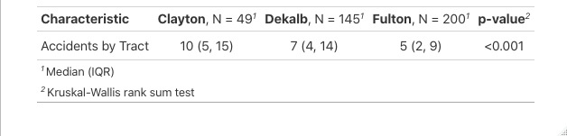
Results: Kruskal-Wallis/Dunn Tests
Total crashes
02.
01.
Dunn Test
Kruskal-Wallis
There is a significant difference in accidents per tract between counties (and between counties in general), with Fulton being noticeably lower than the suburban counties.
The difference between the suburban counties and Fulton was significant (p-value < 0.001), while the difference between suburban counties was not (p-value ~ 0.14)
Crashes per capita

Slide 7
CONCLUSION
Census tracts with lower incomes, especially those in the suburban counties, are more likely to experience serious pedestrian-car collisions, and these events are largely clustered in certain intersections/areas of the region.
Collisions are not correlated at the tract level with ways of commuting, nor are they by population density.
While the urban core has clusters, there are many different suburban clusters that are just as dangerous. This is likely tied to the pedestrian infrastructure in the suburban counties being noticeably weaker, as similar clusters are not seen in the suburban areas of Fulton County, but the data collection process to test that would need to be substantial.

Slide 8
Experienced Obstacles
Which jurisdictions to include
The Atlanta metro region encompasses 10 counties, 3 of which are served by MARTA. The remaining 7 have either no public transportation at all, or their own system that takes commuters in/out of the urban core.
Deciding which counties to use was difficult, but since I wanted to test for correlation by taking public transportation, I just chose the 3 MARTA-serving counties.
Absence of good road/intersection data
I wanted to test for relationships between the road type (highway, residential, arterial, etc), but the state doesn't supply good data for that, and having worked with crowd-sourced data in the past, it requires a lot of quality control that I can't do manually.
Absence of full ridership data
I could've tested for a correlation with bus stops, but they have one at most every street (many thousands total), and with no way to find the ridership (only MARTA has that data internally), it made little sense to test for it here.

